Slide 1

SNOW COVER MAPPING OF KOLAHOI GLACIER.
CE-594
Presented By
Rashid Hamid
ROLL NO-234104001
Waquar Ul Islam
ROLL NO-234357003
INDIAN INSTITUTE OF TECHNOLOGY GUWAHATI

Slide 2
INTRODUCTION.
Earth’s cryosphere, comprising glaciers, ice caps, ice sheets, and snow cover, is a crucial component of the Earth's system. Beyond its captivating landscapes, it significantly influences global climate patterns, regulates sea levels, and plays a vital role in water resource management.
Mountains are large landforms raised above the surface of the earth emerging into peaks and ranges. They occupy 22% of the world’s land surface area and are home to about 13% of the world’s population (FAO, 2015)
Major Himalayan glacier-fed rivers such as the Ganges, Indus, and Brahmaputra serve billions of people with fresh water. Any considerable change in this frozen component of the ecosystem can be indicative of the climate change (Karl et al., 1996 ; Brown et al., 2000).
The glacier recession in the Himalayan arc has not only impacted the stream flows but also resulted in the formation of proglacial lakes.
The eco-hydrology of Himalayan catchments relies on the presence of glaciers and snow coverage, along with their associated dynamics. These elements of the Himalayan cryosphere can be regarded as a valuable source of climate variability.

Slide 3
Review of Literature
Guo et. al., (2021) carried out sptio-temporal analysis of Namcha Barwa–Gyala Peri (NBGP) glacier between1987 to 2019 using Landsat time series images and topographic data. They adopted multiple hierarchical object- and rule-based classification (MHORC) scheme to assess glacier and snow changes. The result revealed an accelerating reduction trend in glacial area. The seasonal snow cover experiences a reduction in secular trend and increased fluctuation amplitude.
Mondal et. al., (2023) analyzed sow cover dynamics of Himalaya catchment area of Arunachal Pradesh ad Tawag region using MOD10A2 products and Landsat-5/8 datasets from 2000-2021. The study also oserved a decreasing trend in accumulation period snow cover and an increasing trend in ablation period snow cover for Arunachal Pradesh where as Tawang basin showed stable trends in accumulation and ablation.

Slide 4
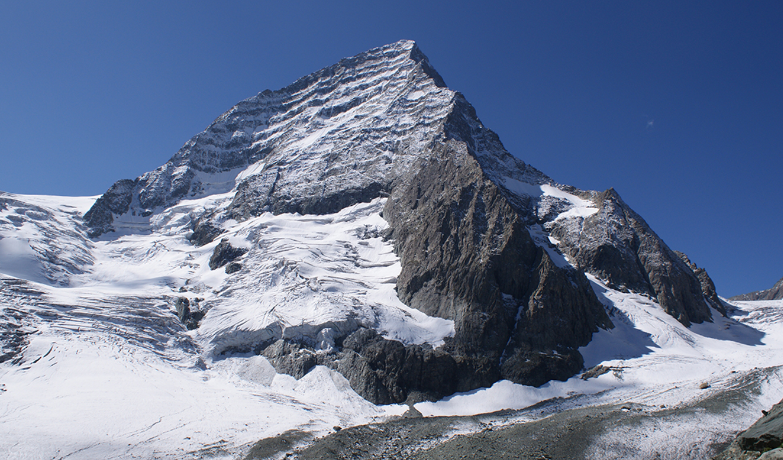
Kolahoi Glacier sits, about 35 kilometres upstream from Pahalgam, at the head of the West Lidder Valley in Kashmir. The glaciated section of this valley is about 5 km in length. Known among the locals as ‘Goddess of Light’, the glacier boosts the rural economy and tourism as the Lidder River feeds the mighty stream of river Jhelum.
STUDY AREA

Slide 5
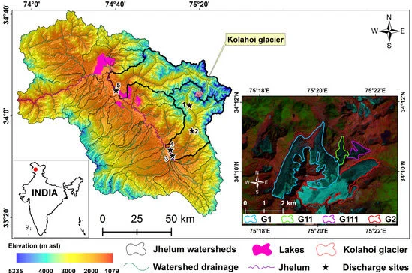
STUDY AREA MAP.

Slide 6
Methodological Framework
Identification of study area
GLIMS (Global Land Ice Measurements from Space) Viewer, Google Earth Pro
Extraction of study area
Randolph Glacier Inventory
Aster Dem of Study Area-Watershed delineation
Arc-GIS
Time-period selection
1990-2020
Imagery source selection
LANDSAT 4-5, LANDSAT 8
Data processing
Arc-GIS
Normalized Difference Snow Index (NDSI)
Analysis
Mann-Kendall Test

Slide 7
Overview About Kolahoi
In the autumn of 2009, a team of scientists from TERI installed an Automatic Weather Station (AWS) at an elevation of 3,925 m in the Kolahoi Glacier Monitoring Observatory. The instrument is equipped with all the essential sensors to measure Kolahoi’s mass balance, which simply put, is growing less in winter and shrinking more in summer.
The measurements of mass balance and the study of satellite data show an incremental pace of melting.
This study aimed at finding a similar result through sowcover mapping .

Slide 8
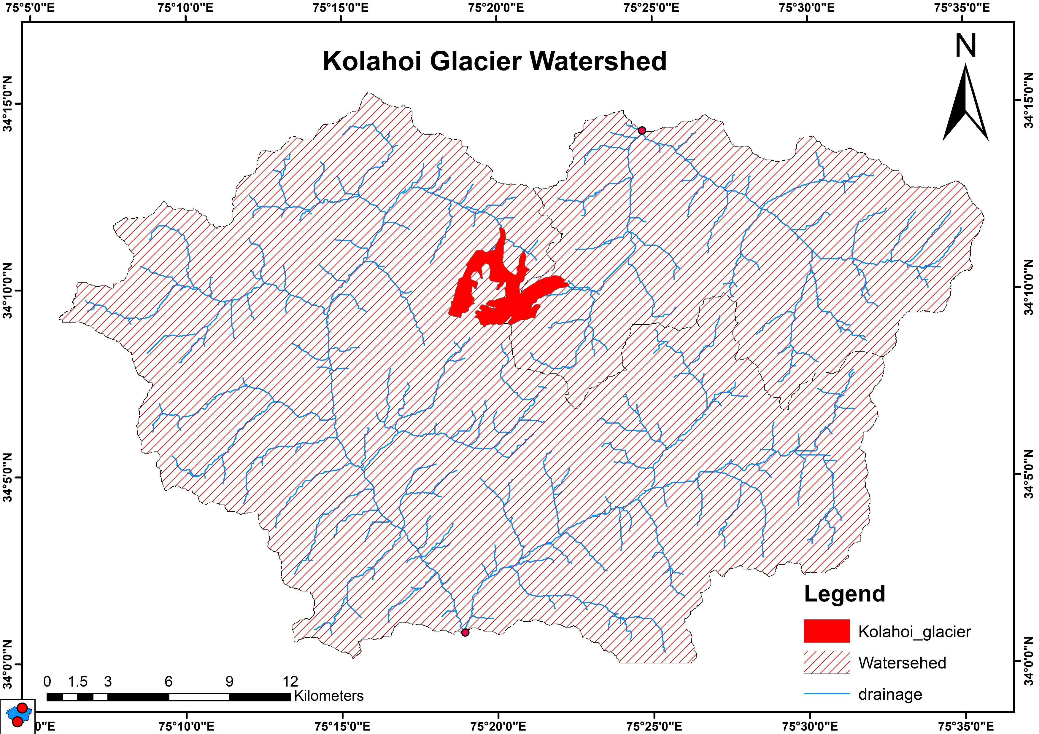
Watershed of kolahoi

Slide 9
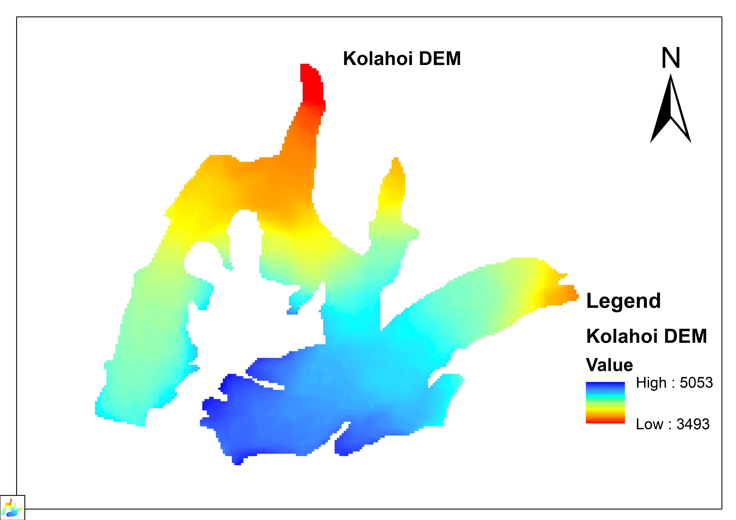

Slide 10
SNOW COVER

Slide 11
Summary statistics
Sen's slope
Variable | Observations | Obs. with missing data | Obs. without missing data | Minimum | Maximum | Mean | Std. deviation
NDSI1 | 31 | 0 | 31 | -0.187 | 0.799 | 0.560 | 0.258
 | Value | Lower bound (95%) | Upper bound (95%)
Slope | -0.002 | -0.008 | 0.003
Intercept | 3.831 | -6.264 | 17.648
Mann-Kendall trend test / Two-tailed test (NDSI1)
Kendall's tau | -0.071
S | -33
Var(S) | 3461.667
p-value (Two-tailed) | 0.587
alpha | 0.05
An approximation has been used to compute the p-value.
Test interpretation:
H0: There is no trend in the series
Ha: There is a trend in the series
As the computed p-value is greater than the significance level alpha=0.05, one cannot reject the null hypothesis H0.

Slide 12
INFERENCE
Mann-kendall Test Result: The Mann-kendall test indicates that the p-value is greater than the significance value of 0.05.
Significance Level: With a p-value above 0.05, we cannot claim statistical significance based on conventional thresholds.Interpretation of
Mann-kendall Test: The Mann-kendall test assesses the presence of Trend in snow cover reduction in time series data. Since the p-value is not significant, we cannot conclude the presence of a significant trend over time in this context.Limitation of
Mann-kendall Test: It's important to note that the Mann-kedall test focuses on detecting monotonic trends and may not capture more complex patterns in the data.
Sen's Slope Result: Despite the non-significant Mann-kadells test result, Sen's slope analysis reveals a negative value.
Interpretation of Sen's Slope: A negative Sen's slope implies a decreasing trend over time.
Conclusion: While the Mann-kanndells test does not show a significant trend, the negative Sen's slope suggests that there is evidence of a decreasing trend in snow cover over the years.
hence a more in-depth analysis is needed to understand the deglaciation pattern apart from snow cover

Slide 13
References
Mondal, S. K., Bharti, R., & Singh, R. P. (2023, July). Mapping Snow Coverage, Contamination and Glacial Lakes of Eastern Himalayas: A Case Study of Arunachal Pradesh and its Tawang River Basin. In IGARSS 2023-2023 IEEE International Geoscience and Remote Sensing Symposium (pp. 110-113). IEEE.
Guo, S., Du, P., Xia, J., Tang, P., Wang, X., Meng, Y., & Wang, H. (2021). Spatiotemporal changes of glacier and seasonal snow fluctuations over the Namcha Barwa–Gyala Peri massif using object-based classification from Landsat time series. ISPRS Journal of Photogrammetry and Remote Sensing, 177, 21-37.
Rai, S. C., & Mukherjee, N. R. (2021). Spatio-temporal change delineation and forecasting of snow/ice-covered areas of Sikkim Himalaya using multispectral and thermal band combinations of Landsat imagery. Environmental Challenges, 4, 100163.

Slide 14
Thank You!

